Slide 1

Health Expenditure and Suicide Rates
By : Devika Jagarlamudi

Slide 2

TABLE OF CONTENT
INTRODUCTION
DATASET
TOOLS USED
PREPROCESSING
EXPLORATARY DATA ANALYSIS
REFERENCES
CONCLUSION

Slide 3

INTRODUCTION
Health expenditure and suicide rates are two critical areas of concern in public health. Health expenditure refers to the resources allocated towards healthcare services, including medical facilities, personnel, equipment, drugs, and other related expenses. Suicide rates, on the other hand, refer to the number of deaths resulting from intentional self-harm. While health expenditure is intended to promote better health outcomes, suicide rates represent a significant public health challenge, with devastating consequences for individuals, families, and communities. There is a growing body of evidence that suggests a possible relationship between health expenditure and suicide rates, making it an important area of research and policy consideration.

Slide 4

DATASET
This dataset is from Kaggle
This data was actually downloaded from the WHO Mortality stats published and ICD10 death classification codes.
Link for the dataset: https://www.kaggle.com/datasets/fernandoretamales/health-expenditure-and-suicide-rates

Slide 5
Attribute Name | Description
Country | Country names
Year | Years
Population | Number of Population
Deaths_All_Types | Total Deaths
Deaths_Suicides | Deaths by suicides according to ICD10
HExp_Pctage_Y | Health Expenditure as % of GDP
MHExp_Pctage_20 | Mental Health Expenditure index in 2011
Dep_Num_2015 | Depression estimate index in 2015
Suicide_p100 | Number of suicides per 100,000 population

Slide 6

LANGUAGES & TOOLS USED
Language
Libraries
Python
NumPy
Pandas
Tools
Google Colab
Tableau

Slide 7

DATA PREPROCESSING
Step1: Importing the required libraries.
Step2: Importing the csv file
Step3: Check for the descriptive analysis of the dataset
Step4: Check for the null values in the dataset
Step 5: As there are no null values in the dataset, we are good to perform the visualization in Tableau.

Slide 8
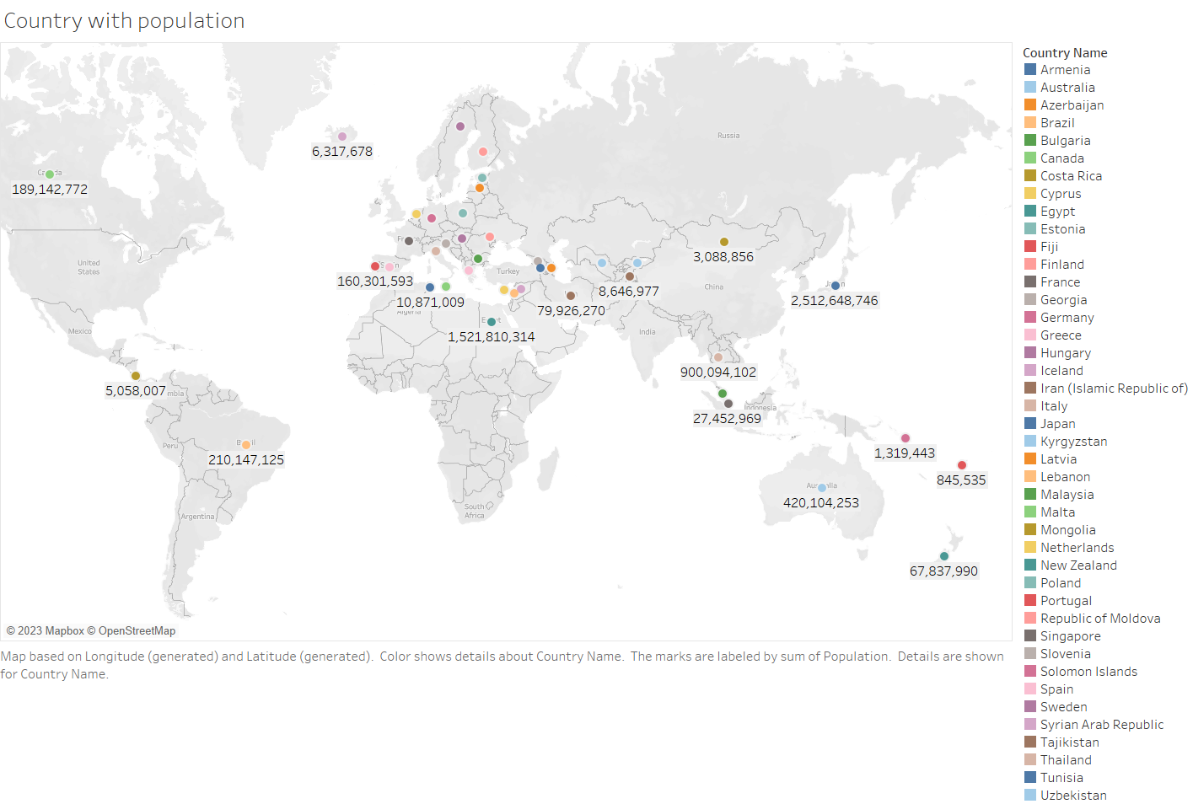
EXPLORTARY DATA ANALYSIS
Inference: This graph shows you the population in the country

Slide 9
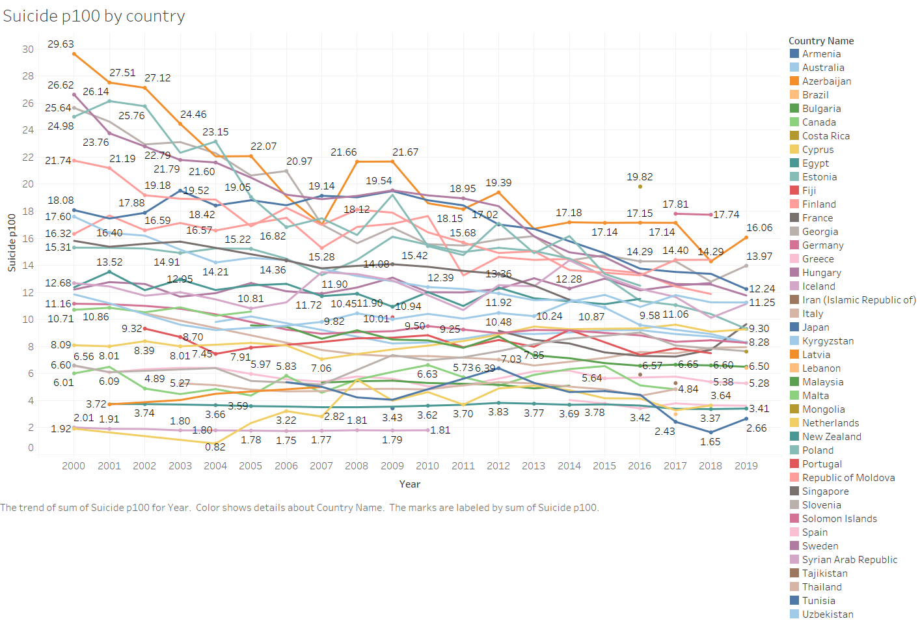
Inference: This line graph shows you the suicide in the different year in the different
countries

Slide 10
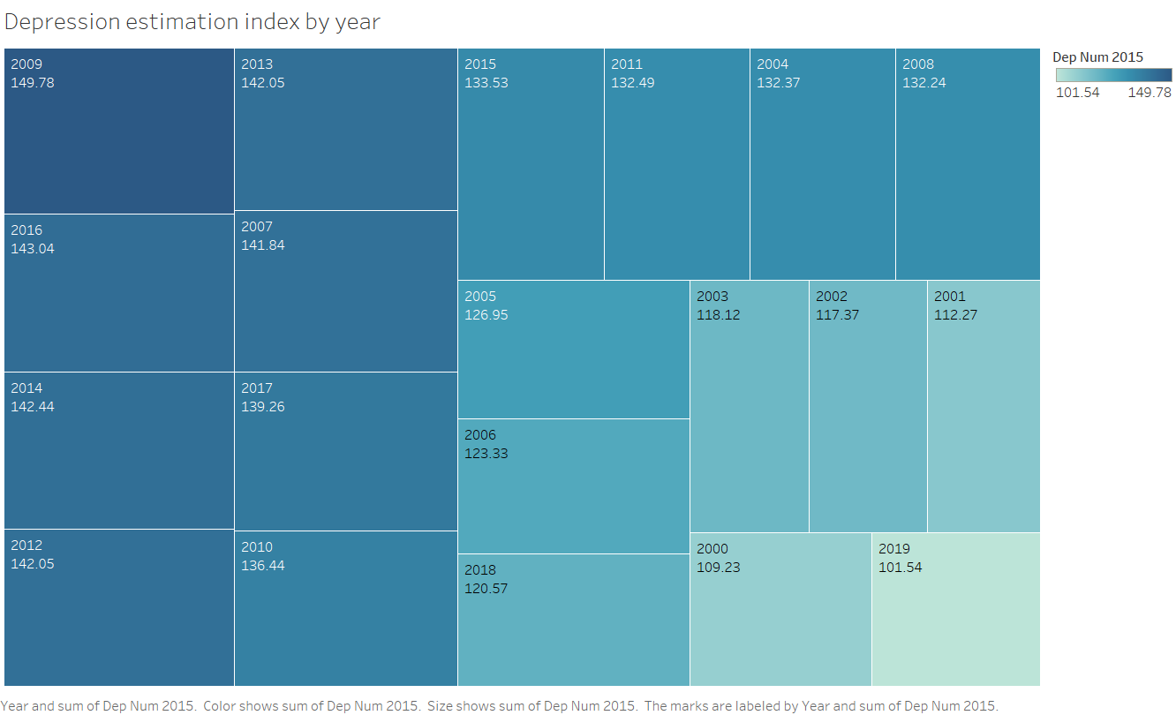
Inference: This graph shows you the depression estimation index in the different years.

Slide 11
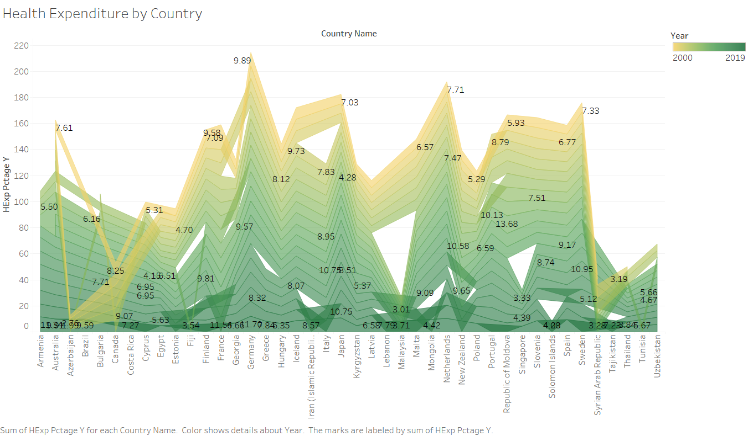
Inference: This graph shows you the health expenditure in the different countries

Slide 12
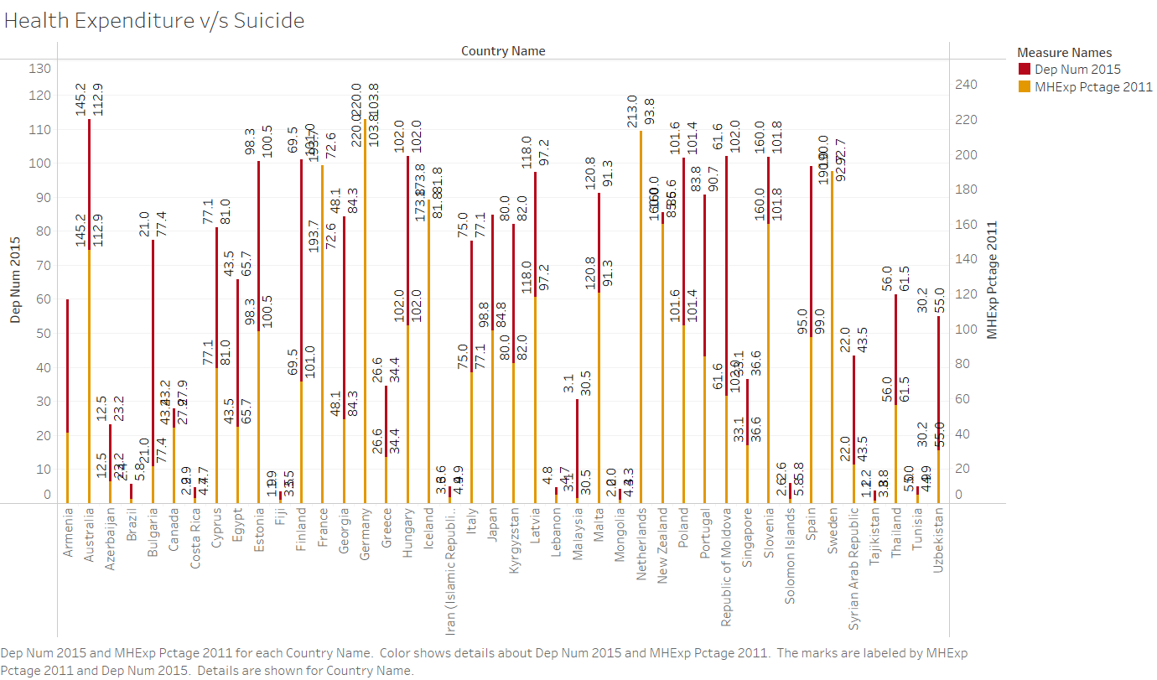
Inference: This graph shows you the health expenditure and suicide in the country

Slide 13
THANK YOU

